Slide 1
Long Short-Term Memory-Networks (LSTMN) for Machine Reading
Ege Ersü

Slide 2
Task: Sentiment Classification
Binary
2 Classes
{positive, negative}
Fine-Grained
5 Classes
{very positive, positive, neutral, negative, very negative}

Slide 3
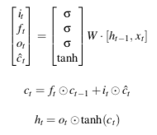
LSTM

Slide 4
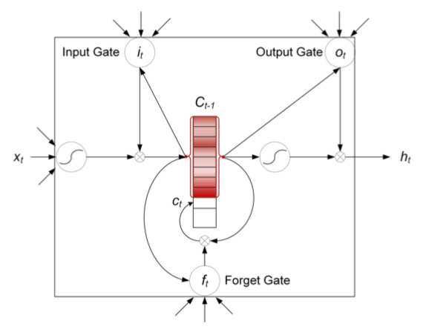
LSTMN = LSTM + external memory

Slide 5
LSTMN = LSTM + external memory
h₁ | h₂ | h₃ | h₄ | h₅
+
c₁ | c₂ | c₃ | c₄ | c₅

Slide 6
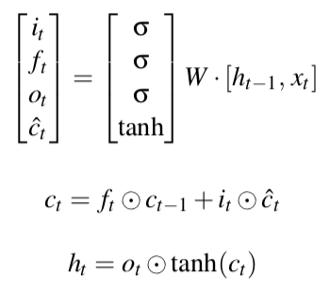
Motivation for LSTMN
Assumption 1
(h_{t-1} , c_{t-1}) alone summarizes the tokens it has seen so far.
Fix: Memory
h₁ | h₂ | h₃ | ... | h_{t-1}
c₁ | c₂ | c₃ | ... | c_{t-1}

Slide 7
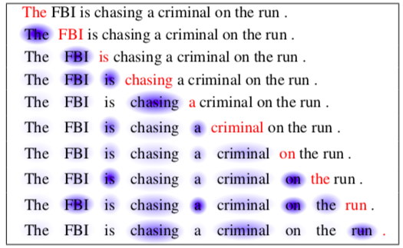
Assumption 2
Token-by-token processing in sequential order is enough.
Problem: Not modeling relations between tokens.
Fix: Attention

Slide 8
t = 4
s^{t} : [0.02 0.52 0.46]
h₁ | h₂ | h₃
h̃
h₄
c₁ | c₂ | c₃
c̃
c₄

Slide 9
Dataset: Stanford Sentiment Treebank
Fine-Grained Classification
11855 Sentences
Train: 8544, Validation: 1101, Test: 2210
Binary Classification
9613 Sentences
Train: 6920, Validation: 872, Test: 1821
Positive: 4972, Negative: 4641
Average Sentence Length: 19.1
Max Sentence Length: 56

Slide 10
Hyperparameters
Batch Size: 5
Embedding Size: 300
Hidden Size: 100
Dropout: 0.5
Memory: KnetArray [Hidden Size, Batch Size, Max Timestep]
Padding: Until 56

Slide 11
Training
Adam
LR: 0.002
Beta1: 0.9
Beta2: 0.999
Binary Classification Training Duration: 14hrs
Fine-Grained Classification Training Duration: 16hrs

Slide 12
Results
Model | Binary Accuracy | Fine-Grained Accuracy
LSTM | 84.78 | 46.22
LSTMN | 86.08 | 46.04
2-Layer LSTMN | 76.52 | -
Model | Binary Accuracy | Fine-Grained Accuracy
LSTM | 84.9 | 46.4
LSTMN | 86.3 | 47.6
2-Layer LSTMN | 87.0 | 47.9
E. Ersü
J. Cheng et al.

Slide 13
Correct Label | Sentence | Prediction
Positive | Skip work to see it at the first opportunity. | Neutral
Very Positive | A worthwhile way to spend two hours. | Positive
Positive | It's both a necessary political work and a fascinating documentary | Very Positive
 | Disturbing and brilliant documentary

Slide 14
Correct Label | Sentence | Prediction
Positive | Skip work to see it at the first opportunity. | Neutral
Very Positive | A worthwhile way to spend two hours. | Positive
Positive | It's both a necessary political work and a fascinating documentary | Very Positive
Very Positive | Disturbing and brilliant documentary | Neutral

Slide 15
Code
github.com/egeersu/LSTMN
Questions?

